Slide 1

Library Management System
- By Shreya Kotalwar

Slide 2




Objective
Digital management of books in library.

Slide 3
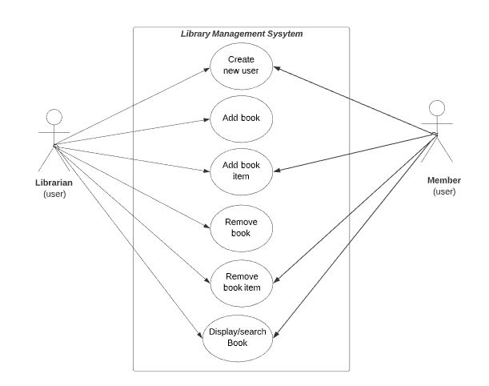
Use Case diagram

Slide 4
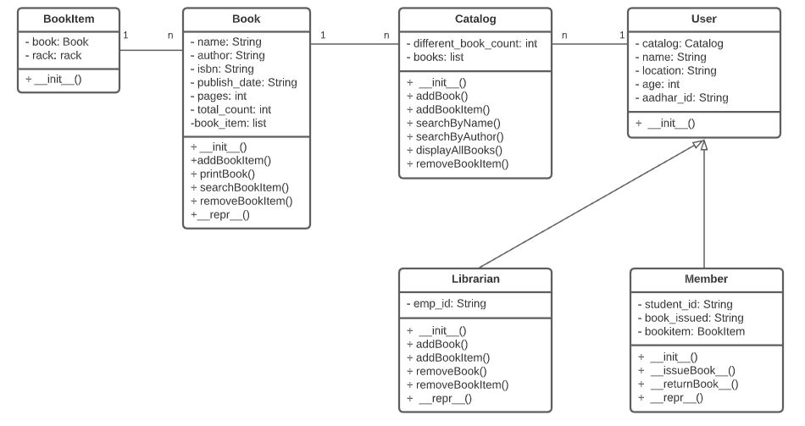
Class diagram

Slide 5

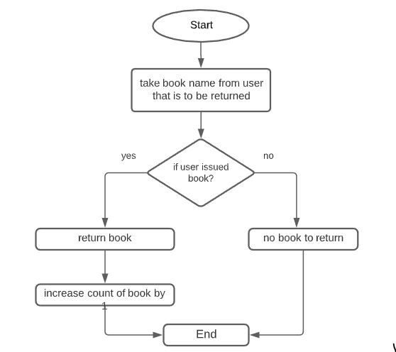
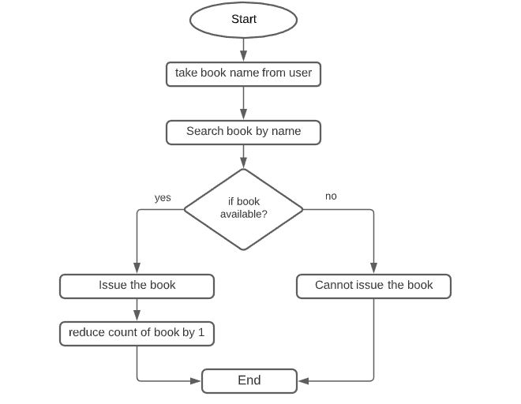
Flow charts
Flow chart for Issue book
Flow chart for Return book

Slide 6

Thankyou!!

